Slide 1
Employee Data Analysis using Excel
STUDENT NAME : SIVASHANKARI K
REGISTER NO : 122203905
DEPARTMENT : B.COM (CORPORATE SECRETARYSHIP)
COLLEGE : Shri Shankarlal Sundarbai Shasun Jain College

Slide 2
PROJECT TITLE
Employee Performance Analysis using Excel

Slide 3


AGENDA
Problem Statement
Project Overview
End Users
Our Solution and Proposition
Dataset Description
Modelling Approach
Results and Discussion
Conclusion
3/21/2024 Annual Review

Slide 4

PROBLEM STATEMENT
Employee Data Analysis is made to track the performance of employees. High performance employees are appreciated with Increament in salaries, bonus etc.. Low performers are motivated to do better and this is why Employee Data Analysis is made.

Slide 5

PROJECT OVERVIEW
.
Employee performance analysis involves evaluating how well employees meet job expectations and contribute to organizational goals. It includes assessing various metrics such as productivity, quality of work, and adherence to deadlines. Feedback from supervisors, self-assessments, and peer reviews are often incorporated. The analysis aims to identify strengths, areas for improvement, and training needs. Ultimately, it supports better decision-making regarding promotions, rewards, and professional development.

Slide 6
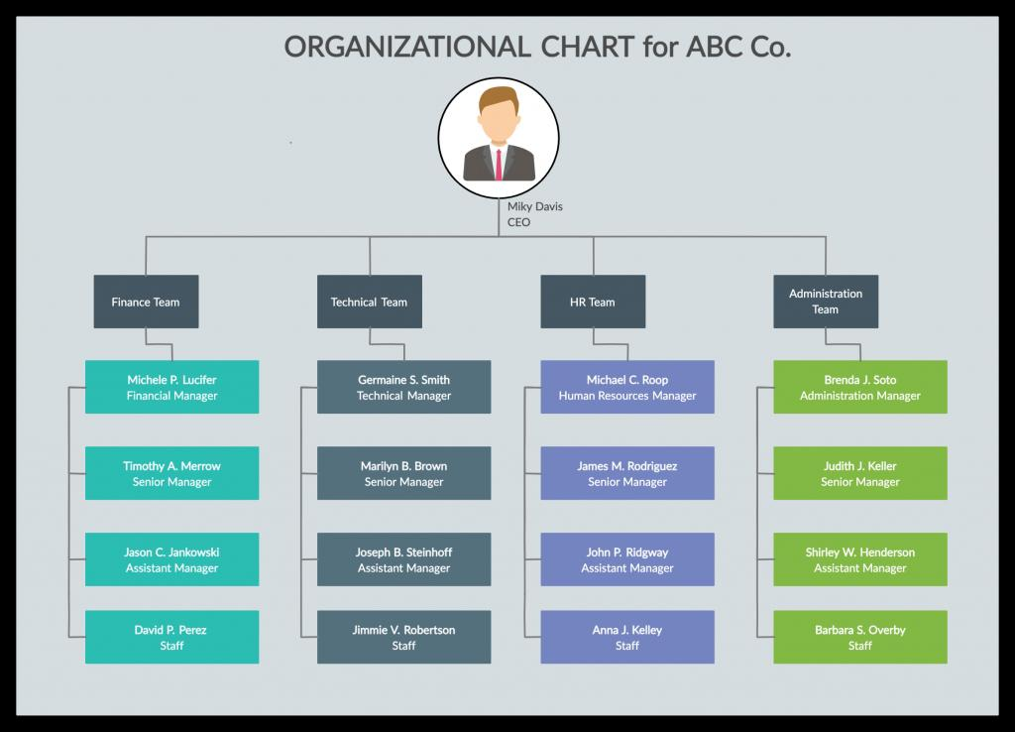

WHO ARE THE END USERS?

Slide 7

OUR SOLUTION AND ITS VALUE PROPOSITION
Conditional Formatting – Missing
Filter – Remove
Formula – Performance
Pivot – Summary
Graph – Data Visualization

Slide 8

Dataset Description
Employee Data set – Kaggle 26 features:- Only some of them have been considered: Employee ID Employee First Name Employee Last Name Employee Status Employee Performance Level Current Employee Ratings Department Type Division Job Function

Slide 9

THE "WOW" IN OUR SOLUTION
Idea:
Performance Level =IF(Z6>=5, "VERY HIGH", IF(Z6>=4, "HIGH", IF(Z6>=3, "MED", "LOW")))
3/21/2024 Annual Review
9

Slide 10
MODELLING
STEPS:-
1)Data Collection
Go to Kaggle and download
Download in Edunet Dashboard
2) Features Collection
9 Features
Employee ID
Employee First Name
Employee Last Name
Employee Status
Employee Performance Level
Current Employee Ratings
Department Type
Division
Job Function
10

Slide 11
MODELLING
3) Data Cleaning
Missing Values identified- Conditional Formatting
Missing Values removed – Filtering
4) Performance Level Calculation
Performance Level Formula = IFS(Z8>=5,”VERY HIGH”,Z8>=4,”HIGH”,Z8>=3,”MED”,”TRUE”,”LOW”)
5) Summary/Pivot Table
Features/Techniques Used
What Columns Used
Employee ID
Employee First Name
Employee Last Name
Employee Status
5. Employee Performance Level
6. Current Employee Ratings
7. Department Type
8. Division
9. Job Function

Slide 12
MODELLING
6) Graph
Data Visualisation
Features/Columns Used
Employee Performance Level
Current Employee Ratings
Department Type
Division
Job Function
Employee ID
Employee First Name
Employee Last Name
Employee Status

Slide 13
RESULTS
13

Slide 14
Conclusion
While comparing the performance of the employees, the number of employees are higher in number in average performing category. High level and very high level employees are very few in number. So, the management should motivate the average performing employees to perform better and be effective. They can motivate these employees by giving them different levels of tasks based on their performance and strength. To conclude, medium performing employees are large in number. We need to motivate them for a better outcome. There are ups and downs in the performance of the employees. High Level performing employees in WBL Business Unit are more in number when compared to other departments.

